Slide 1
Micro to macroclimatic scaling effects on foundation plant species interaction with vertebrate protégé species.
Nargol Ghazian
Progress Report
Spring 2019

Slide 2
Summary
Chapter | Title
1 | A picture is worth a thousand hours: a systematic review of camera trap papers to test for reported sampling effort.
2 | Plant-animal interactions and microclimate.
3 | The importance of microclimatic refuges in deserts via shelters.

Slide 3
Timeline
Jan-Feb
Mar-Apr
May-June
Jul-Aug
Sep-Oct
Nov-Dec
2020
Mar-Apr
May-June
Jul
2020
Today
Meta-analysis data extraction
1/27/2019
2/8/2019
Abstracts reviewed for eligiblity
2/9/2019
3/4/2019
3/18/2019
Full-text data extraction
6/30/2019
7/1/2019
Chapter 1 Draft
10/1/2019
Field Season
5/15/2019
6/15/2019
Camera trap data analysis and chapter 2 draft
10/2/2019
12/31/2019
Shelter data extracted
8/12/2019
Prelim. data collection
1/5/2019
1/21/2019
1/1/2020
Chapter 3 data analysis and draft
7/1/2020

Slide 4
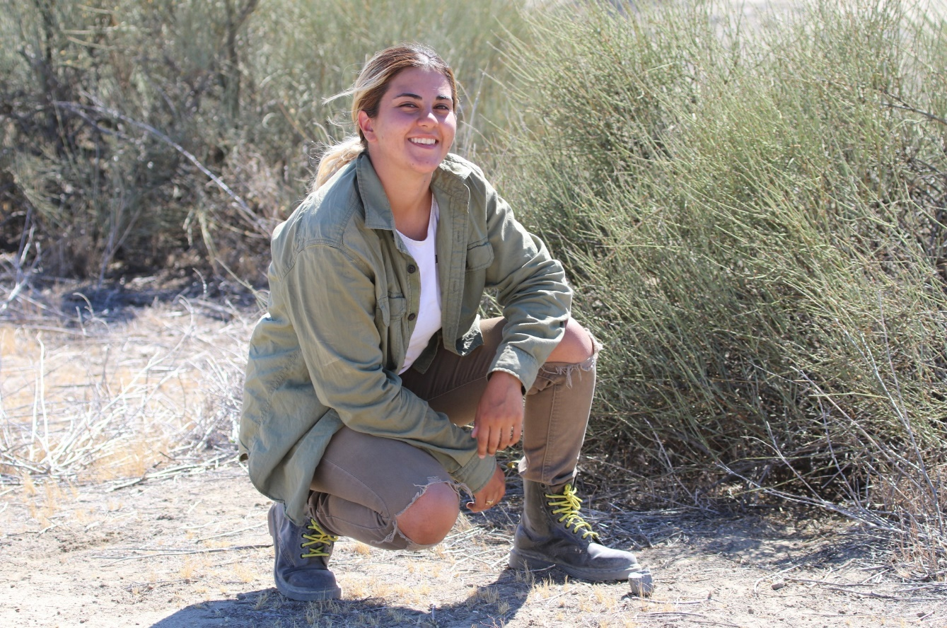
Background
Competition switches to facilitation under stressful environmental conditions-SGH (Bertness and Callaway 1994).
Climate as a stressor is typically not explored, nor reported properly.
Drylands are home to many, rare endemic species.
For small animals, deserts are extremely heterogeneous at fine scales.
Thus, climate data are needed at a macro and micro scale.
Ephedra californica
Notes:
Ephedra californica (Google Images)

Slide 5
CH1: A picture is worth a thousand hours: A systematic review of camera trap papers to test for reported sampling effort.
Purpose: To Identify the relevant literature using camera traps to examine species richness and diversity as an index of sampling effort.
Questions:
How many hours, days, or months are needed to estimate species richness and diversity in a given ecosystem using a camera trapping tool?
What taxa are usually recorded?
Does the temperature of the study period function as a covariate when predicting species richness?

Slide 6
Papers obtained through database searching (Web of Science) Keywords:
Camera* Trap* AND Richness*, Diversity*, and Rarefaction* Curve*
(n= 515)
Identification
Papers obtained from other sources, such as book chapter bibliographies
(n= 0)
Records after duplicates removed (n = 397)
Eligibility
Records screened by abstract (n = 397)
Records excluded for: relevance, review, opinion or idea paper, focus on one spices, qualitative, not English.
Screening
Full-text articles assessed for eligibility (n = 252)
Full-text articles excluded:
Not reporting richness or diversity, number of records, and any measure of duration.
Include in synthesis
(n = )
Extracted data:
Location (lat, long), duration.hours, duration.months, camera trap days, number of records, animal richness, scientific name, year, number of cameras, number of sites, month of study, type of ecosystem, study design, and some measure of temperature for study period
Included
PRISMA diagram (Moher et al. 2009). Keyword search done on January 27th, 2019.
Notes:
PRISMA diagram (Moher et al. 2009). Keyword search done on January 27th, 2019.

Slide 7
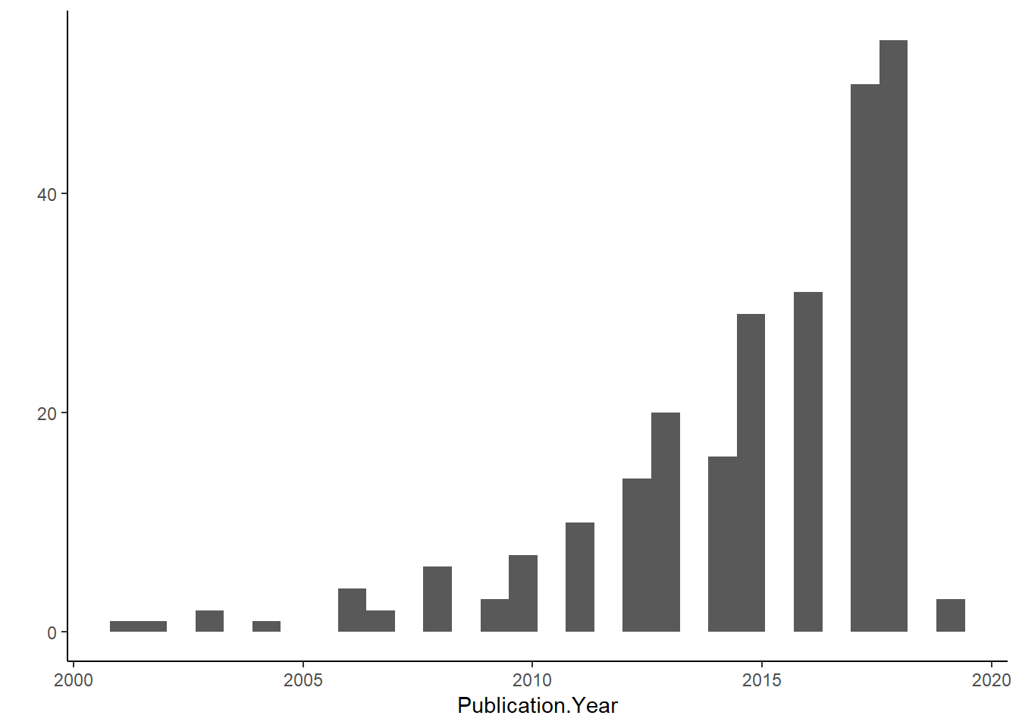
Preliminary Results
515 studies were selected
397 when duplicates were removed
Most papers were wildlife monitoring or agricultural studies
Data is being extracted from 252 articles

Slide 8
CH2: Plant animal interactions and microclimate.
Purpose: To examine whether animal association patterns with shrubs are explained by microsite level fluctuations in temperature and light.
Hypothesis: Shrubs act as thermal refuges for many desert animals by reducing temperature, reducing the amplitude of variation in microclimate, and reducing solar radiation.

Slide 9
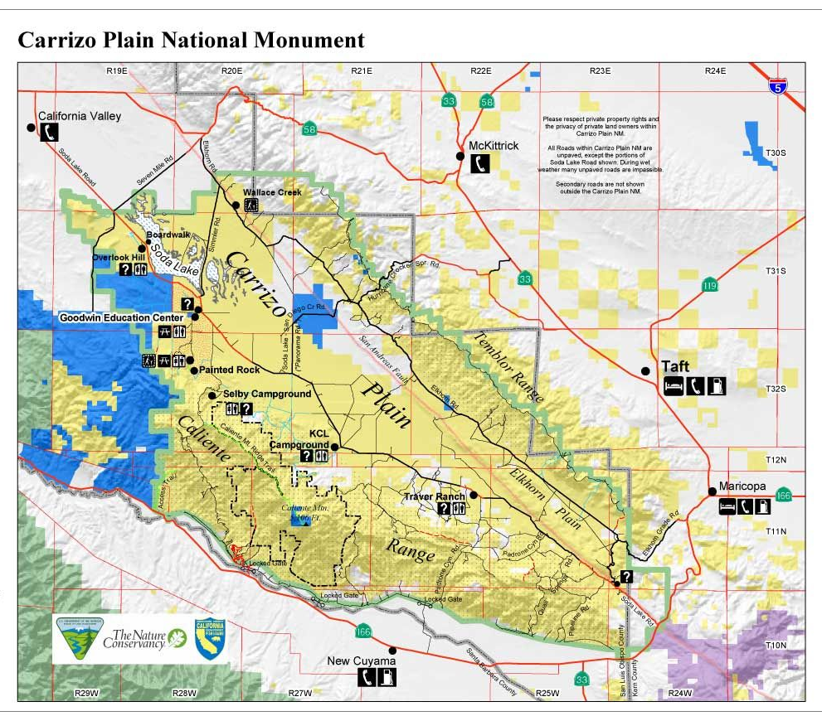
3
4
(Google Images)
Notes:
3

Slide 10





There are more animals associated with shrubs relative to open, non-canopy sites and the strength of this relationship increases with micro-environmental stress.

Slide 11
2. Shrub size predicts the strength of association between shrubs and protégé animals.

Slide 12
3. The facilitation refuge effect may be enhanced between abundance and richness of animal populations.
4. Microclimatic (ones site) and mesoclimatic (multiple sites) measures are more significant predictors of fine-scale animal abundances relative to the macroclimate of the region.

Slide 13

Methods
Open
3 meters
3 meters

Slide 14
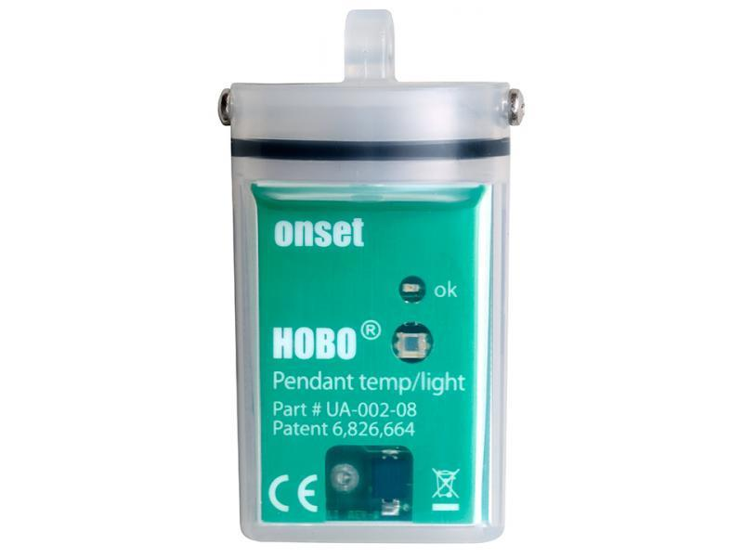
2 sets of temperature pendants
Better than logger: Not chewed by animals
30 minute intervals
One in soil
Ones secured to a peg (with zip ties), 2-3 cm above ground for air temperature
Onset HOBO temperature and light pendants, 8K

Slide 15
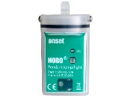
Methods
Open
3 meters
3 meters

Slide 16
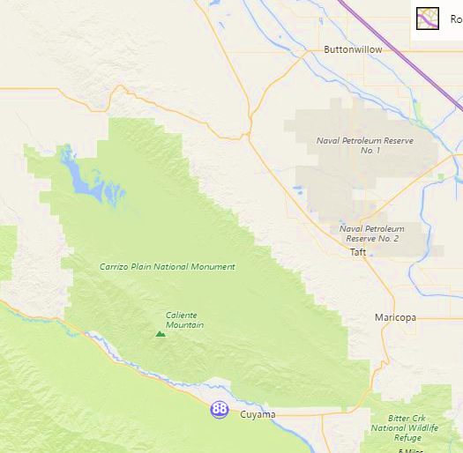
Preliminary Results
California Irrigation Management Information System (CIMIS) Cuyama weather station

Slide 17
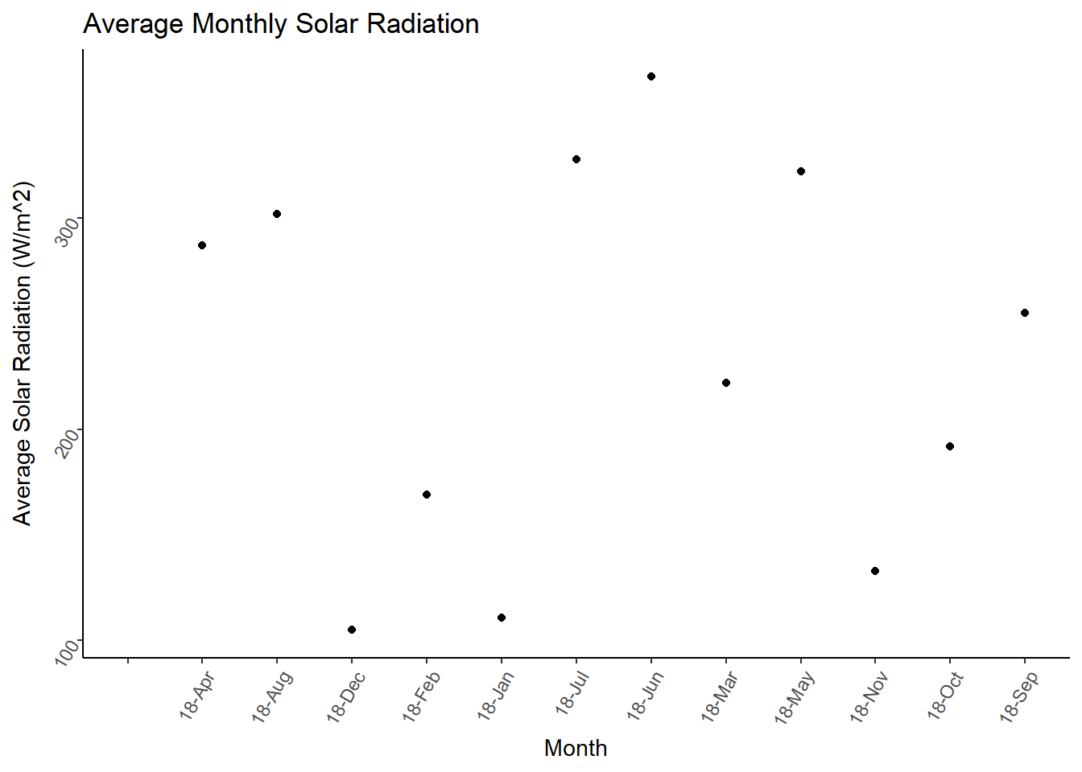

Slide 18
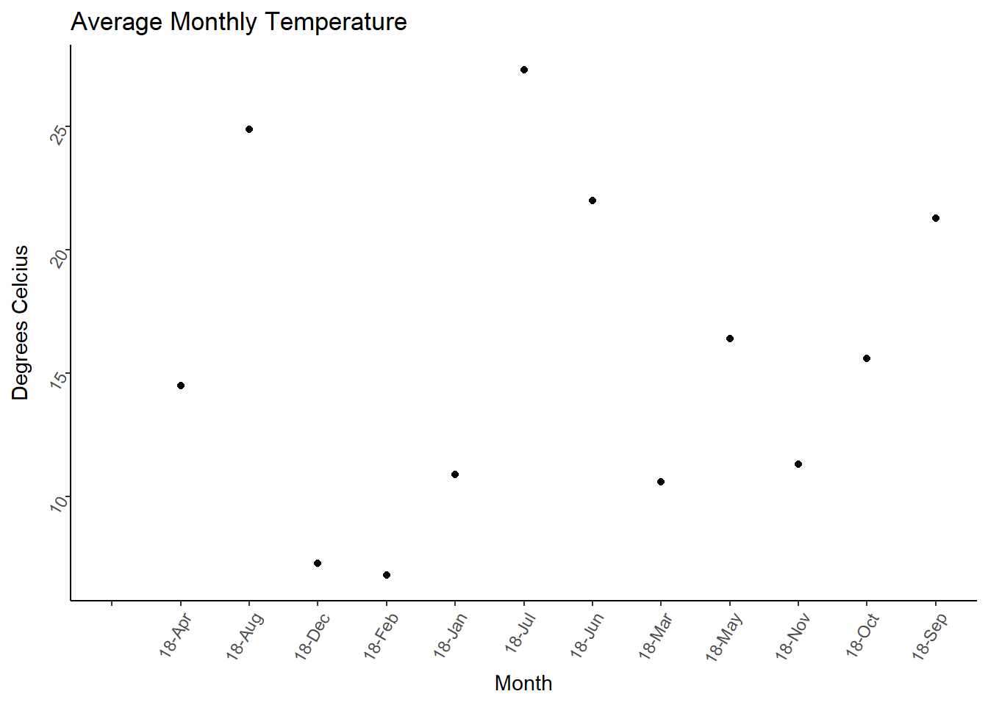

Slide 19
Precipitation was negatively correlated with average solar radiation
(Pearson’s Correlation, cor= -0.28, p-Value=0.37>0.05).
Precipitation was negatively correlated with average air temperature
(Pearson’s Correlation, cor= -0.48, p-Value=0.11>0.05)
Average air temperature was negatively correlated with wind speed (Pearson’s Correlation, cor= -0.104, p-Value=0.75>0.05)

Slide 20
CH3: The importance of microclimatic refuges in deserts via shelters .
Questions:
How does the canopy coverage of shelters differ?
To what extent does the material and design affect temperature and light fluctuations?
What are the implications of this study for different climate change scenarios?

Slide 21
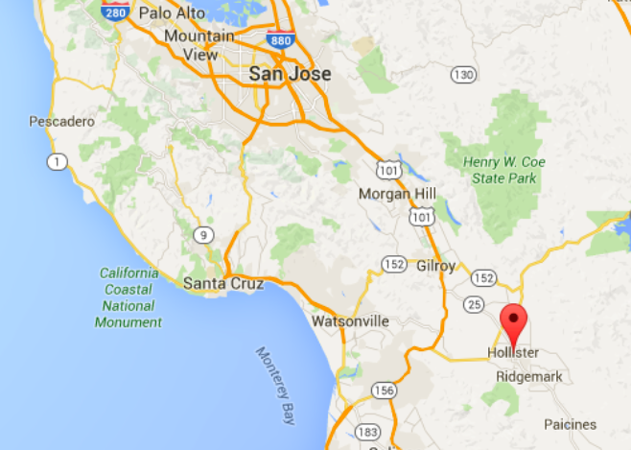
(Google Maps)

Slide 22
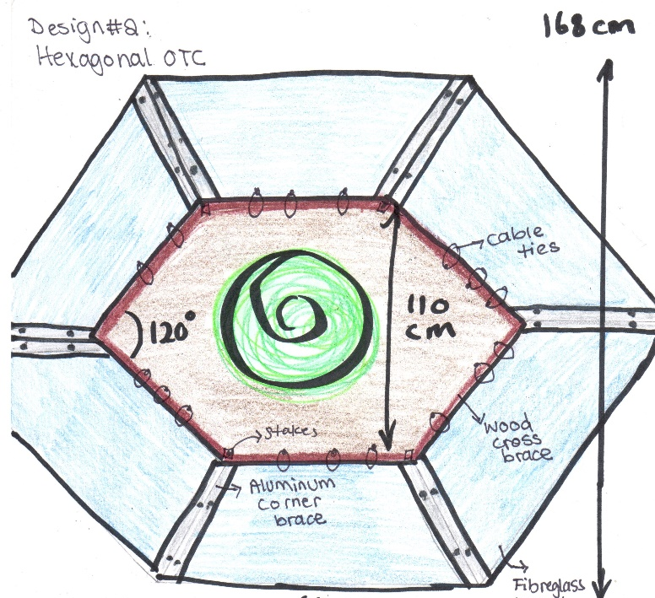
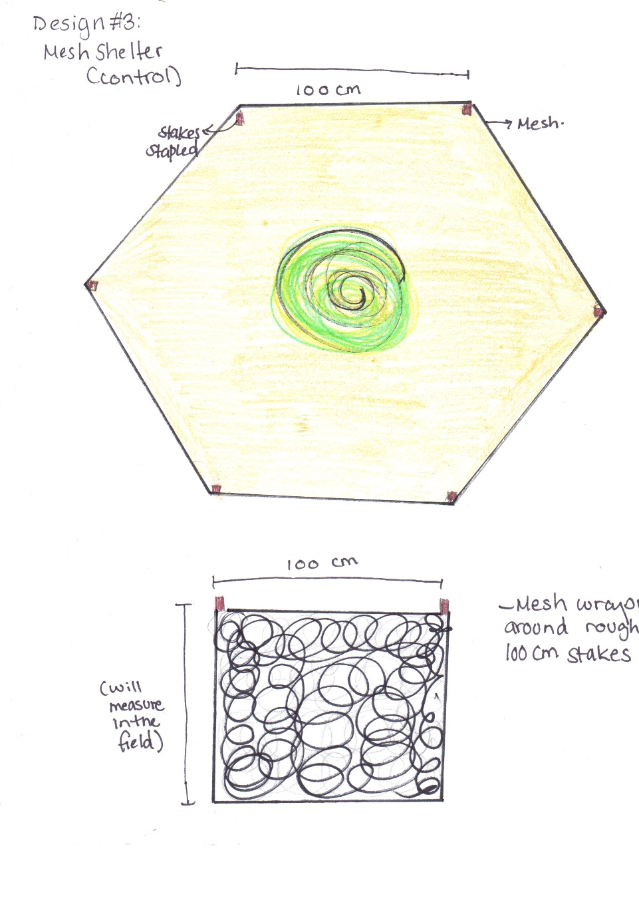
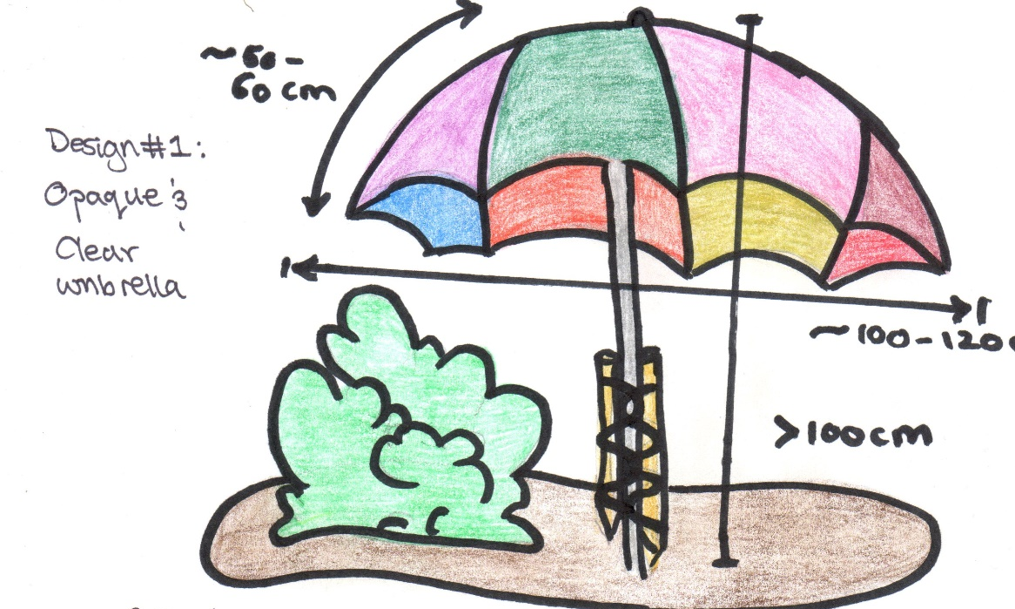
Open Top Chamber (OTC)
Umbrella opaque and clear
Mesh control

Slide 23
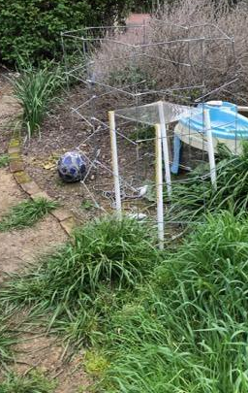
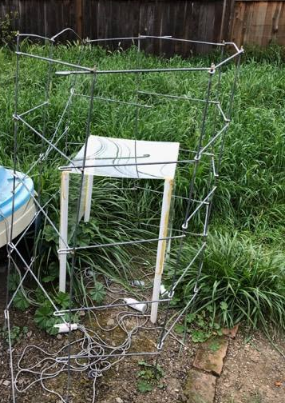
Shelter prototype

Slide 24
New Proposal
Change:
Material
Shape
Flat panel x4 materials
Or 2-3 shapes with sides and 1-2 material only
Pan trapping

Slide 25
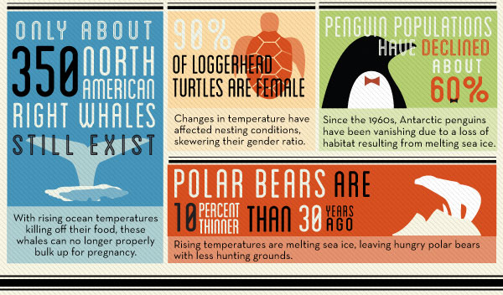
Implications
(NATGEO)

